Slide 1
BITNG PROJECT UPDATE
Carl Demolder
Date 12/16/2020

Slide 2
Outline
Progress to date
LP ECG
Schedule
Gantt Chart update
Path forward

Slide 3
PROGRESS TO DATE

Slide 4
Progress from last week
LP ECG
Firmware development
PCB layout

Slide 5
SHRINER’S PROJECT

Slide 6
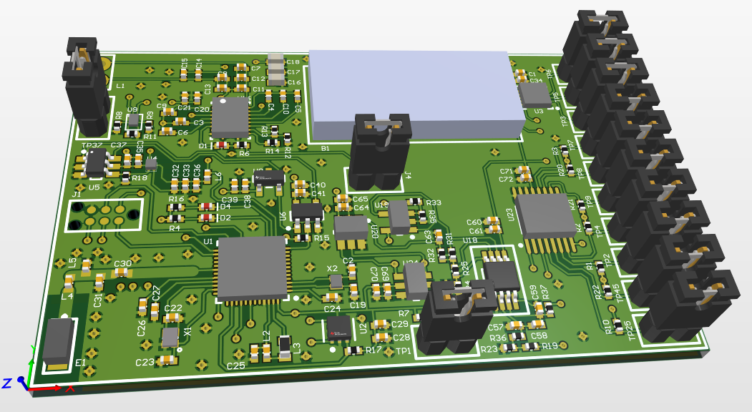
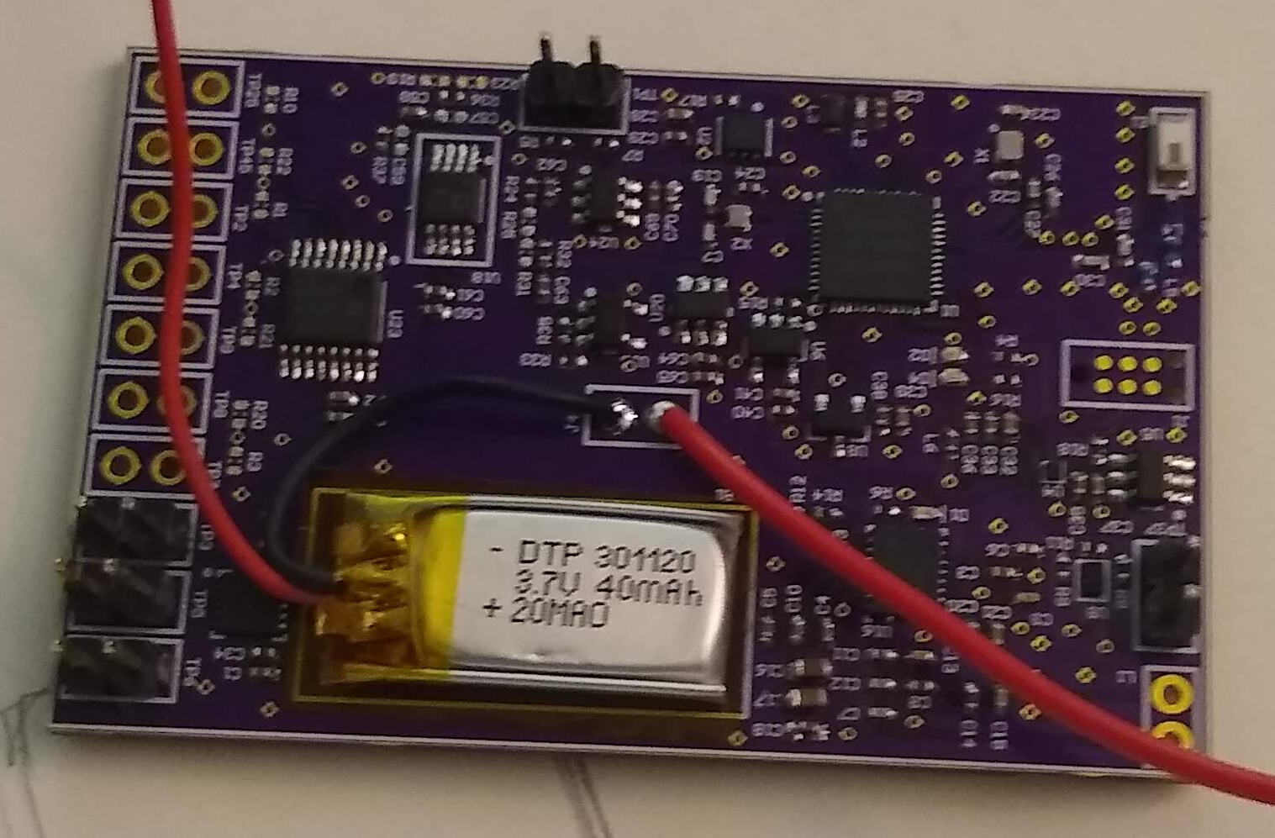
PCB design
PCB: Arrived
Stencil: Arrived
Digikey: Arrived
Assembly: Complete
Hardware Debug: Completed
Programming Check: TO DO

Slide 7
LP ECG PROJECT

Slide 8
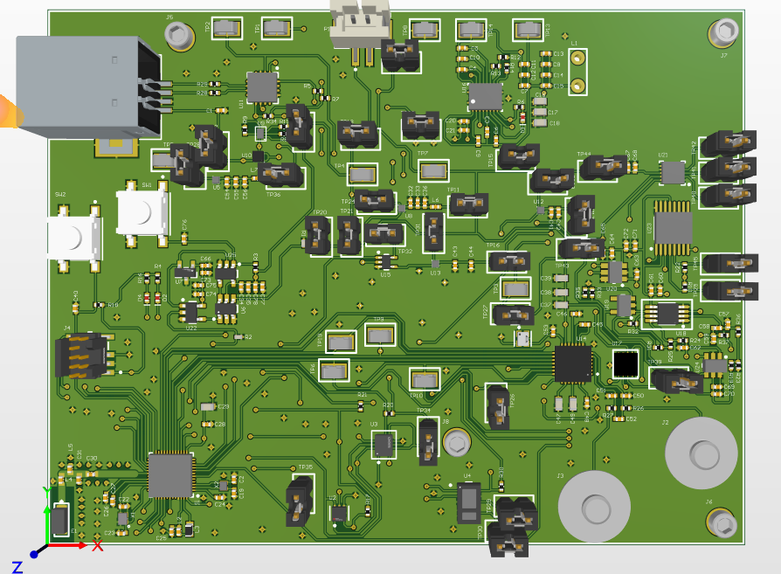
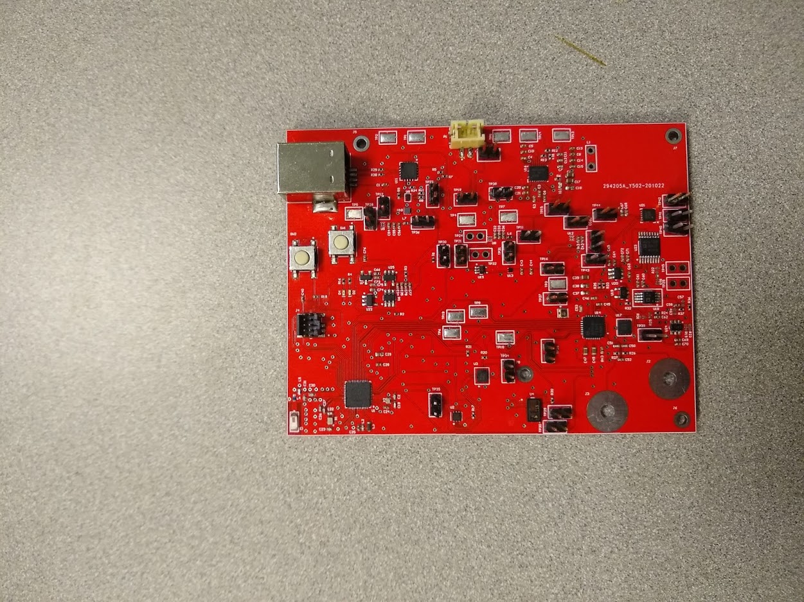
PCB design
PCB: Arrived
Stencil: Arrived
Digikey: Arrived
Assembly: Completed
Hardware Debug: Completed
Programming Check: TO DO

Slide 9
Firmware
ECG
MAX30003
Drivers
Optimization
FRAM
CY15B108QI
Drivers
Optimization
NRF52
BLE
Power Optimization
RTC
Debugging

Slide 10
GATT Server [ECG Patch]
Service | Characteristic | Data Type | Read/Write | Notification
Configuration | Settings | uint8_t [10] | Write/Read | NO
 | Response | uint8_t [2] | Read | Yes
 | CRC | uint8_t [2] | Read | Yes
Temperature | Temperature | uint8_t [250] | Read | Yes
ECG | ECG | uint8_t [250] | Read | Yes

Slide 11
ECG Patch - Wakeup
Serial Handler
Bluetooth
Handler
Wave magnet over patch
Magnet Removed
Power Manager
YES
CHECK IF SERIAL DEBUGGER ATTACHED
NO
Trigger Hall Effect Sensor
LED Driver
Enable LDO
Enable VCC LDO
LED Blink
Init
CY15B108QI
VCC Supplied to MCU
Enable
LDO Drivers
Init/Start
HF CLOCK
Init
MAX30003
Peripheral Initialization
I/O Pins
Init/Start
LF CLOCK
Init/Start
SPIM Driver
Log Driver
NRFX Clock Driver
Init/Start
TWIM Driver
Init
TMP117 & RTC
<1 second

Slide 12
Bluetooth Handler
BLE Connection Established
Init BLE Stack
Shutdown
LED Blink
Init GAP Parameters
NO
GATT Client Discovers Services
Check connection before timeout
YES
GATT Server changes “Response” Characteristic to report error performing requested operation
Init GATT
Subscribe to characteristic notifications
Init BLE Advertising
Start Advertising
GATT Server writes “Response” Characteristic to “Initialization” Command & Sends Notification
FAILURE
Set BLE Advertising Power
Enable DC/DC Converter
Change setting or perform action
GATT Client changes “Settings” Characteristic
Init Connection Parameters
Init Peer Manager
GATT Server changes “Response” Characteristic to send request status and sends notification to GATT Client
SUCCESS

Slide 13
Data Recording Initialization
GATT Client Sends Command to Read Firmware and Hardware Version
GATT Client Sends Command to Shutdown
Disable/Uninit Unused Peripheral Drivers
Enter Low Power Mode
Check if HW & FW Versions are Up to Date
Start MAX30003 Data Recording
Wait for Interrupt
NO
GATT Client sends command to change sampling rate
YES
Start RTC for TMP117
Check Temperature and ECG Sampling Rate
NO
GATT Client Sends Command to Change Recording Session Duration
LED Blink
YES
Check Recording Session Duration
NO
GATT Server Disconnects BLE
GATT Client Sends Command to Start Recording Session
GATT Server Sends Confirmation Through “Response” Characteristic and Sends Notification

Slide 14
Data Interrupt
Interrupt Occurred
Init/Start TWIM Driver
Read Temperature Value from TMP117
Wakeup CY15B108QI
Write Data to Registers
TMP117
TMP117 RTC or MAX30003?
Disable/Uninit Unused Peripheral Drivers
Deep Sleep CY15B108QI
MAX30003
Init/Start SPIM Driver
Enter Low Power Mode
Read Status Register
Reset FIFO Register
Disable/Uninit Unused Peripheral Drivers
Check FIFO Overflow
YES
Deep Sleep CY15B108QI
NO
Read FIFO Memory
Wakeup CY15B108QI
Write Data to Registers

Slide 15
Recording Session Timeout
Recording Session Timeout
Shutdown
ECG Data Available for Transfer
Temperature Data Available for Transfer
NO
NO
Start Advertising
YES
YES
BLE Connection
NO
GATT Server Writes Data to “ECG” Characteristic & Sends Notification to GATT Client
GATT Server Writes Data to “Temperature” Characteristic & Sends Notification to GATT Client
YES
GATT Server Writes “Response” Characteristic To “Data Ready” Command & Sends Notification
GATT Client Reads “ECG” Characteristic
GATT Client reads “Temperature” Characteristic
Init/Start SPIM Driver
Read Data off CY15B108QI
Wakeup CY15B108QI
Check Data Available to Transfer
NO
Deep Sleep CY15B108QI
Disable/Uninit Unused Peripheral Drivers
Enter Low Power Mode

Slide 16
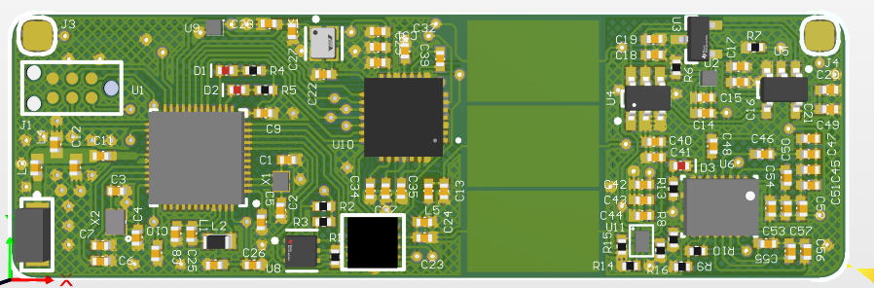
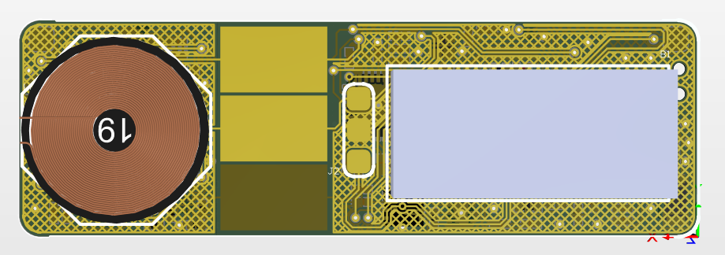
PCB layout

Slide 17
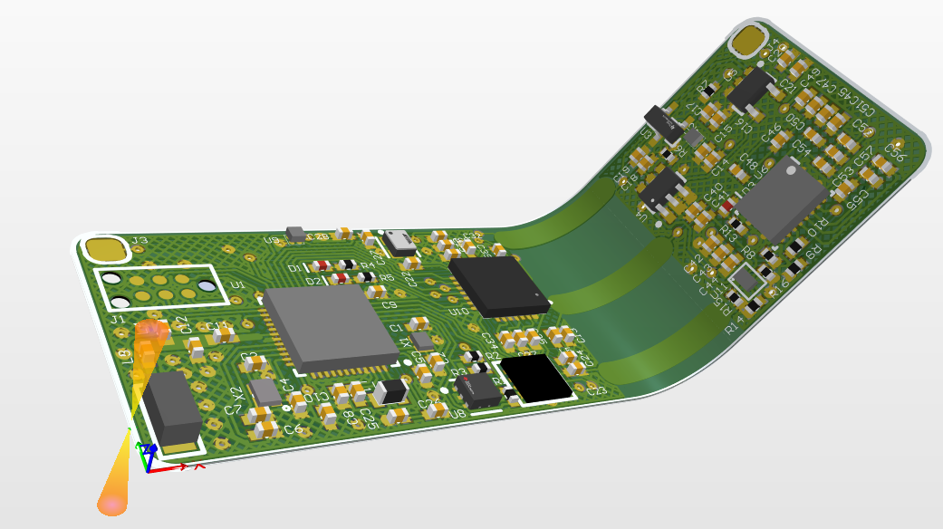
PCB layout
SUBMITTED

Slide 18
STRAIN SENSOR

Slide 19
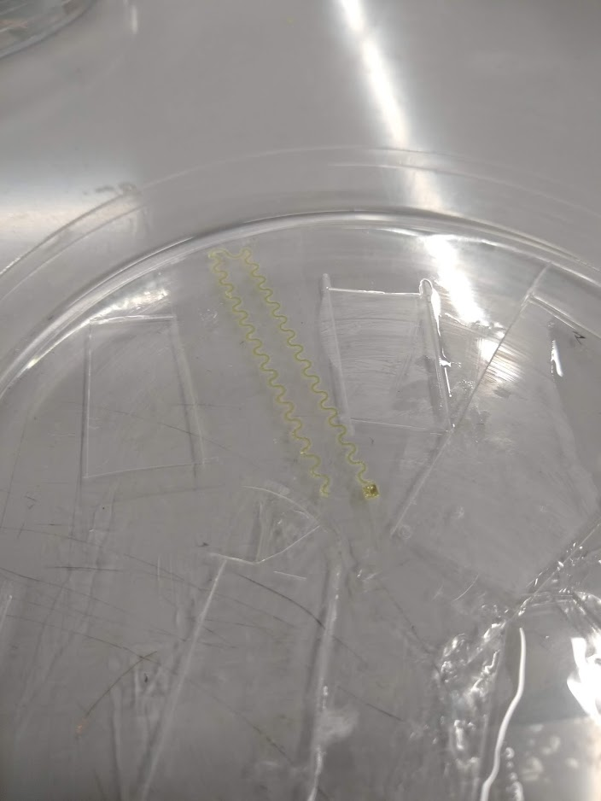
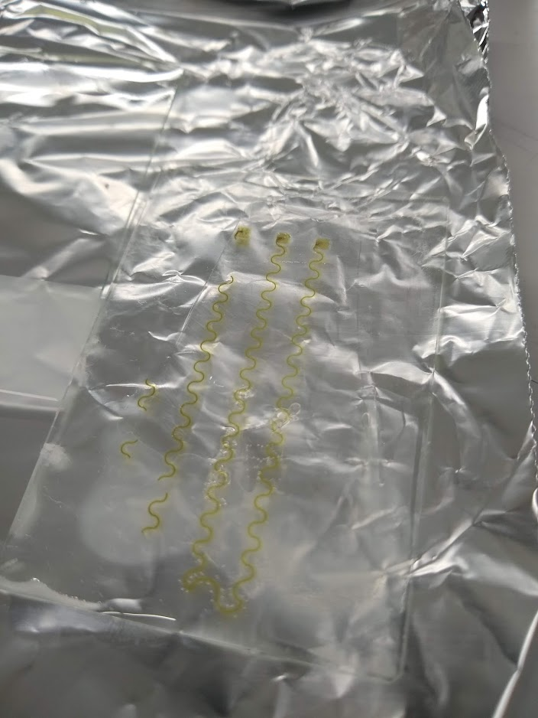
Strain Sensor: Round #1
PDMA: Finished
PI: Finished
AG NW: Finished
PDMS: Finished
ASSEMBLY: FAILED
ENCAPSULATION: FAILED
Characterization: FAILED
Not enough nano-wires
Broken pads

Slide 20
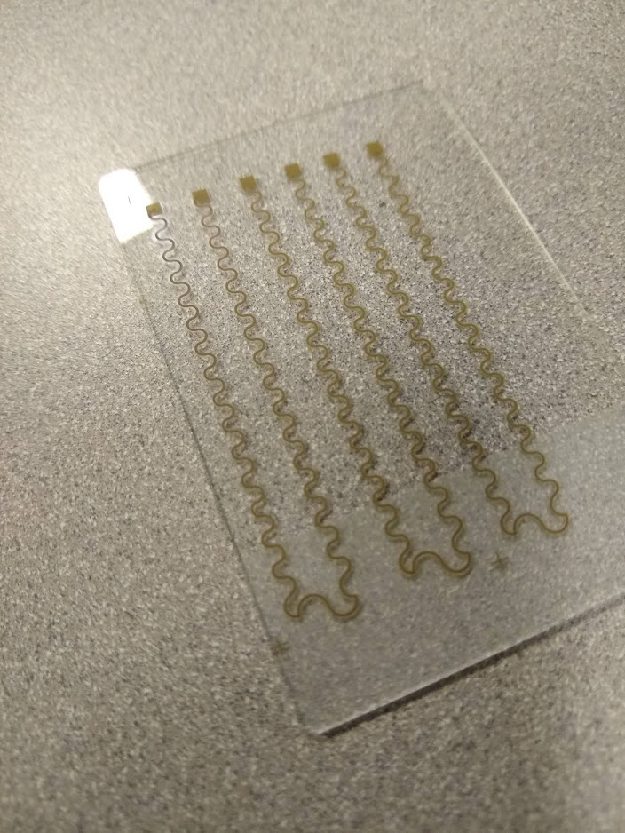
Strain Sensor: Round #2
PDMA: Finished
PI: Finished
AG NW: Finished
Conductivity Test: FAILED
PDMS: TO-DO
ASSEMBLY: TO-DO
ENCAPSULATION: TO-DO
Characterization: TO-DO

Slide 21
PATH FORWARD

Slide 22
Path forward (12/14/20 – 12/21/20)
LP ECG:
Firmware development
Flexible PCB design
Shriner’s Project:
Literature review
Tables and figures

Slide 23
SCHEDULE

Slide 24
Schedule Gantt chart
Task | 12/07-12/14 | 12/14-12/21 | 12/21-12/28 | 12/28-1/4 | 1/4-1/11 | 1/11-1/18 | 1/11-1/18
LOW POWER ECG
-PCB ASSEMBLY
-HARDWARE DEBUGGING
-FIRMWARE DEVELOPMENT
-PCB DESIGN
NEUROMOTOR PEDIATRIC WEARABLE
-LITERATURE REVIEW
-PCB ASSEMBLY
-HARDWARE DEBUGGING
-FIRMWARE DEVELOPMENT
-PRESSURE SENSOR MANUFACTURING
-STRAIN SENSOR MANUFACTURING
LEGEND
FINSHED
TO-DO

Slide 25
APPENDIX

Slide 26
CAPACITANCE SENSOR

Slide 27
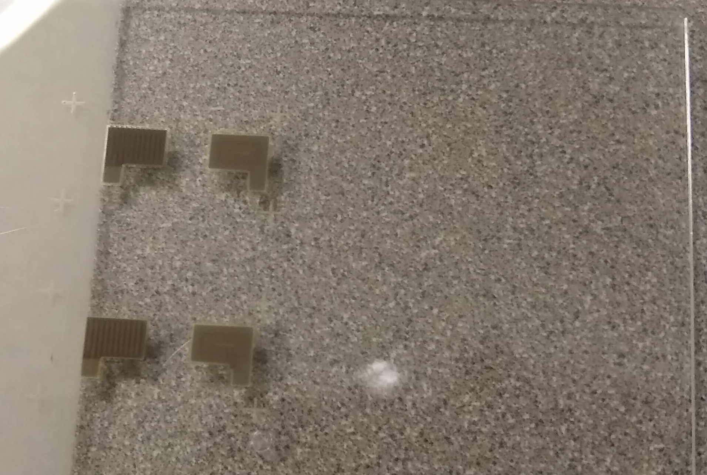
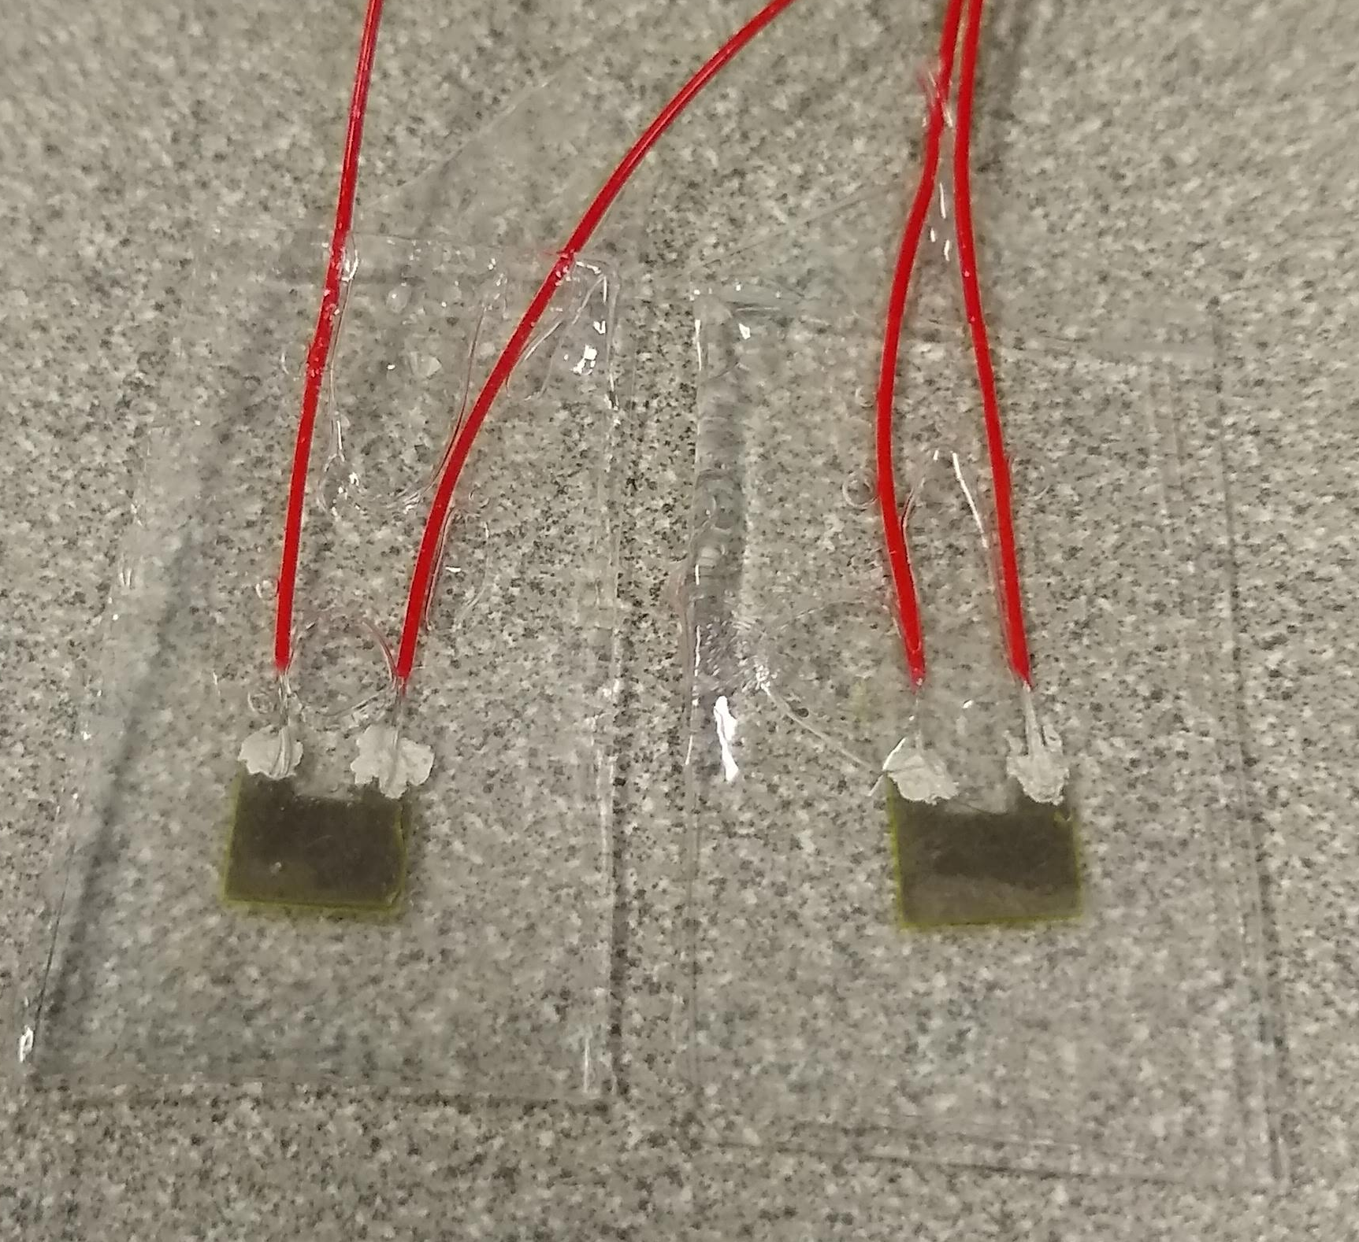
Capacitance sensor
PDMA: Finished
PI: Finished
AG: Finished
PDMS: Finished
ASSEMBLY: Finished
ENCAPSULATION: Finished
Characterization: TO-DO

Slide 28
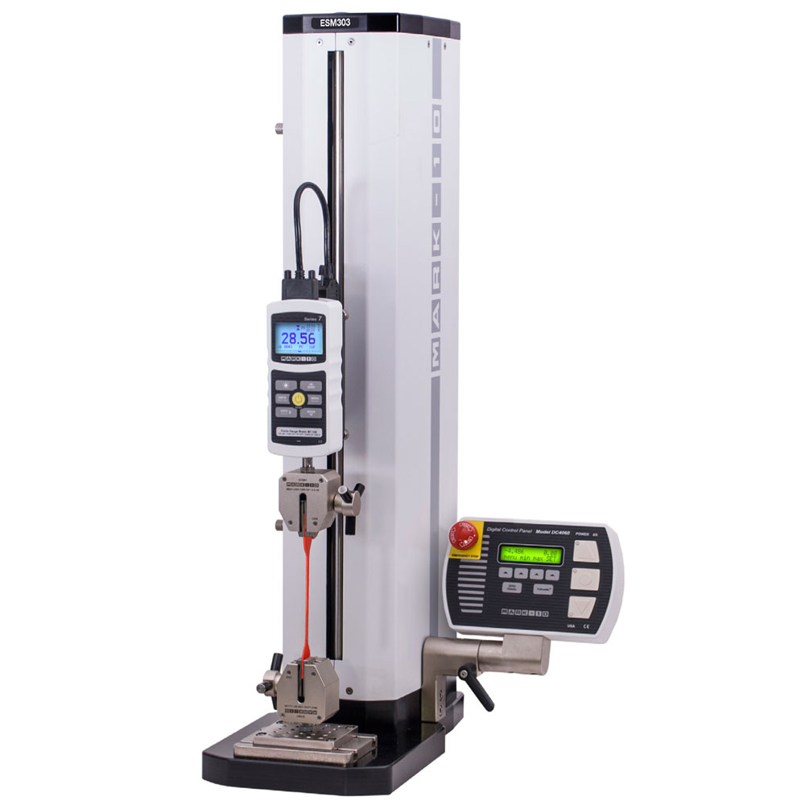
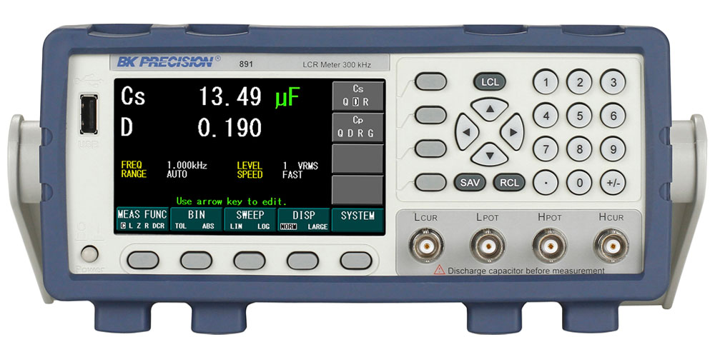
Capacitance/Force characterization
Mark-10 Force Gauge
Automated testing characterization

Slide 29
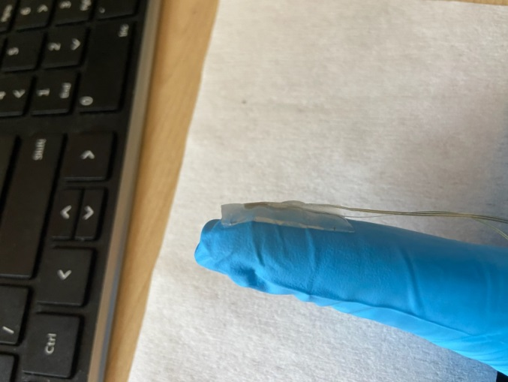
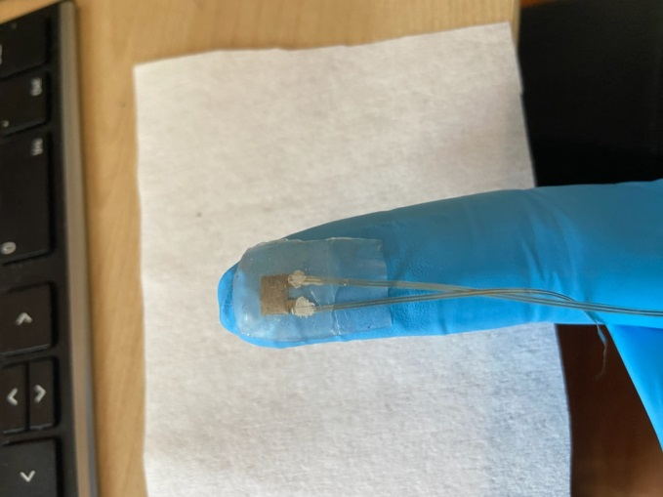
Capacitor sensors
Data collected from Robby
Max capacitance change
20% ~ 10 pF
Increasing pressure

Slide 30
Capacitor sensors
Data collected from Robby
Sensitivity: 0.133 pF/kPa
Pressure threshold > 0.5 kPa
example data
capacitance change
percent change

Slide 31
Capacitance sensor design
Capacitor area (prior art): 3mm x 5mm
Initial capacitance: 52 pF
Sensitivity: 0.133 pF/ kPa
 | Low threshold | High Threshold
Target force (g/N) | 4 / 0.0392 | 180 / 1.764
Target pressure (kPa) | 1.568 | 70.56
Capacitance change (pF/%) | 0.2085 / 0.4 | 9.384 / 18
CDC units | 910 | 40,999

Slide 32
IRB PROPOSAL

Slide 33
IRB proposal
Initial Draft X01:
Draft sent to IRB Review Board on 10/13
Revision X02:
Draft sent to IRB Review Board on 10/26
Revision X03:
Draft sent to IRB Review Board on 10/29
Revision X04:
Draft sent to IRB Review Board on 11/2

Slide 34
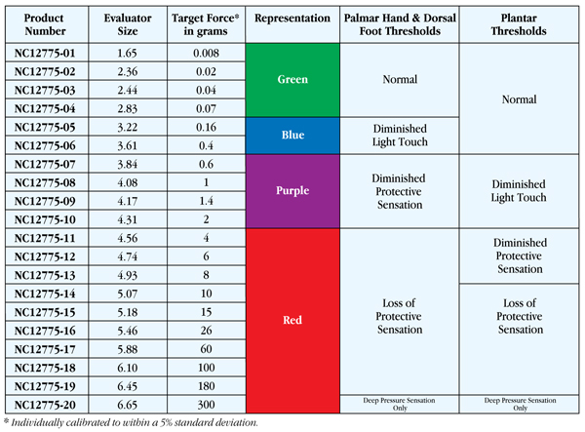
Semmes Weinstein scale
4-180 grams of target force

Slide 35

Block diagram-motherboard
INDUCTIVE
WIRELESS
CHARGING
MOTHERBOARD
Wired Digital Communication
BMS
NRF52832
SENSORY
SENSING CIRCUIT
SENSORY
SENSING
WEARABLE
LIPO
BATTERY
FEEDBACK
ARMBAND

Slide 36
Block diagram-sensory sensing
SENSORY
SENSING
SENSOR GLOVE
PRESSURE
SENSORS [3X]
TEMPERATURE
SENSOR [3X]
GRASP STRAIN
SENSOR [1X]
FINGER STRAIN
SENSOR [3X]
CAPACITIVE
PRESSURE
SENSORS [3X]
RESISTANCE
TEMPERATURE
SENSORS [3X]
RESISTANCE
STRAIN
SENSORS [4X]
CAPACTIVE
SENSING
CIRCUIT [3X]
MOTHERBOARD
RESISTIVE
SENSING
CIRCUIT [7X]
WIRED DIGITAL COMMUNICATION [4 LINES]
NRF52832

Slide 37
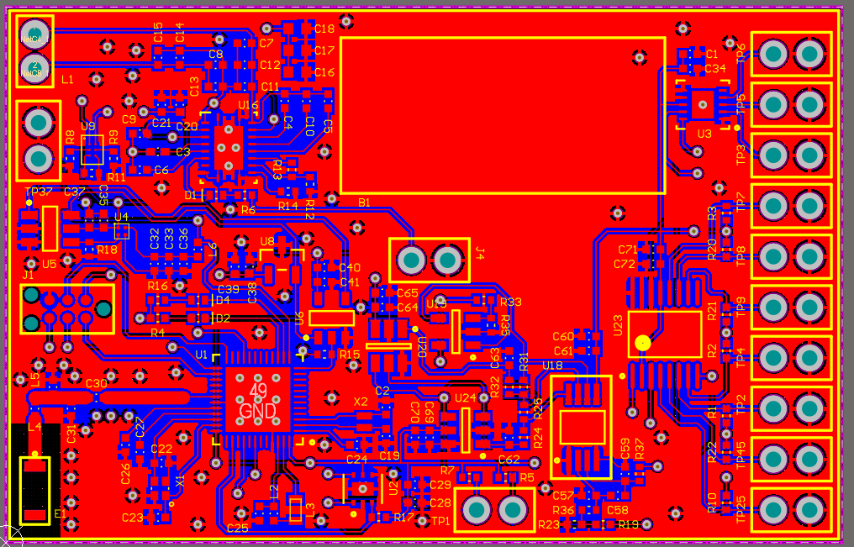
PCB design
~60mm x ~40mm

Slide 38
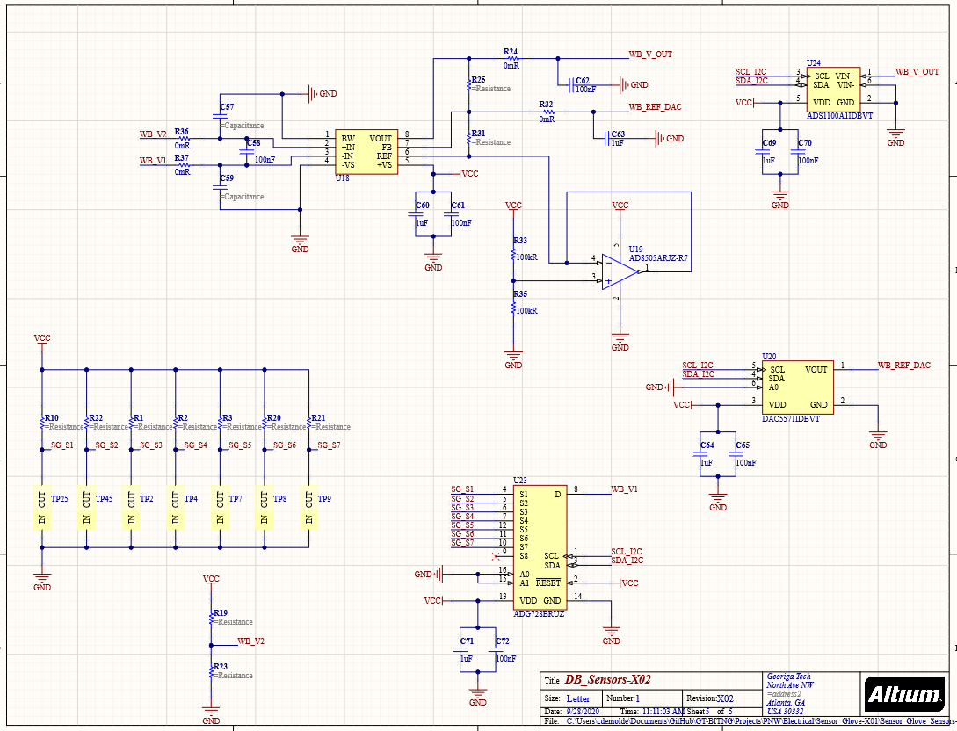
Resistive sensing circuit
Up to 8 resistance sensors

Slide 39
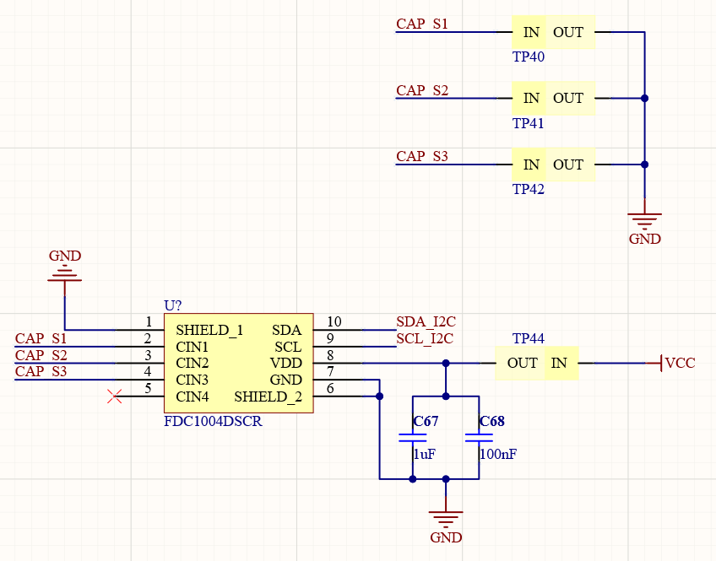
Capacitive sensing circuit
Up to 4 Capacitance sensors**

Slide 40
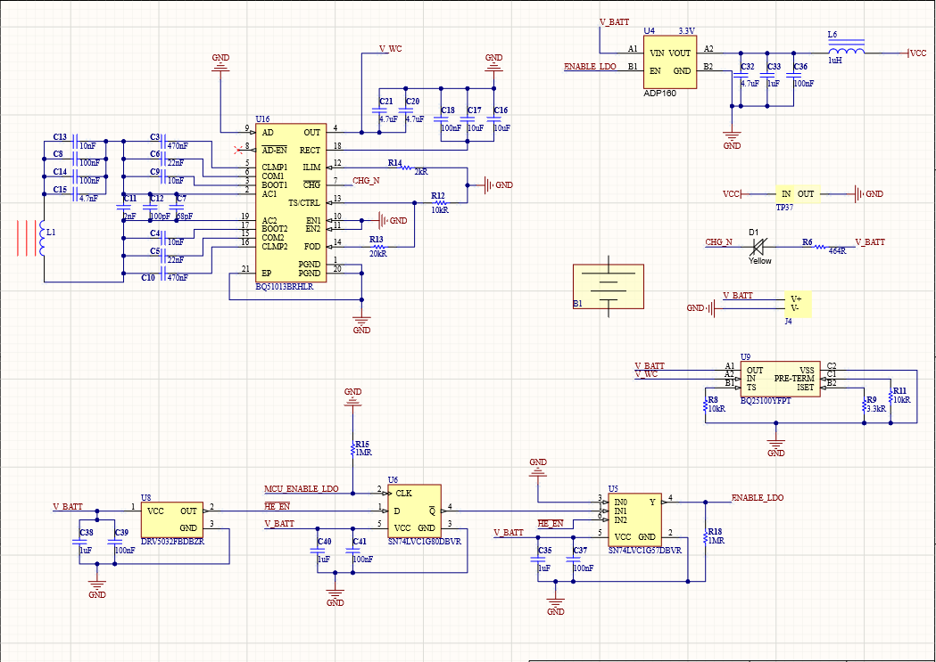
Power circuit

Slide 41
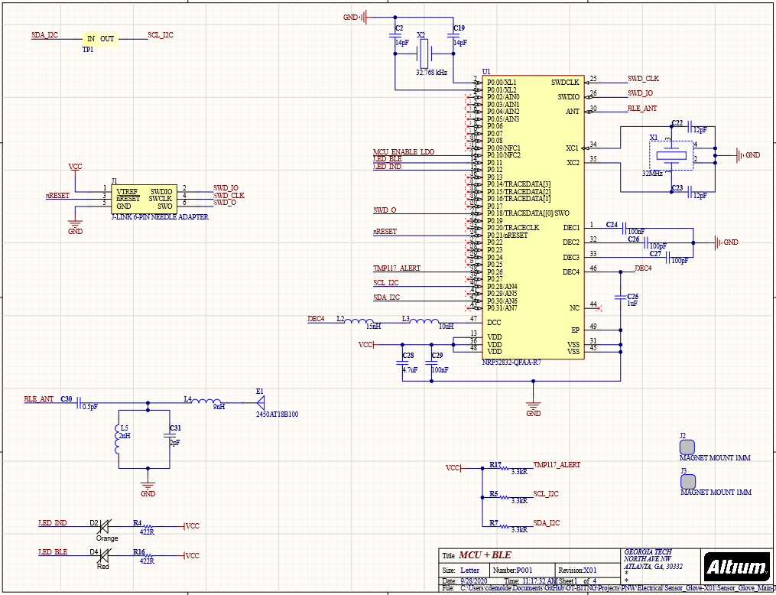
MCU circuit

Slide 42
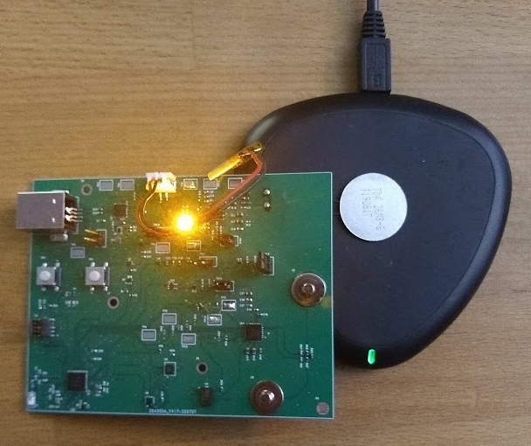
Wireless charging: Inductive
Hardware
Old wireless charging coil:
TDK 45-15F5-G (48.2mm x 32.2mm x 1.0mm)
Current inductive coil:
WR222230-26M8-G (22 mm x 22mm x 0.87 mm)
TRANSMITTER
RECEIVER
CIRCUITRY
FOOTPRINT:
15mm x 15mm
RECEIVER COIL

Slide 43
Wireless charging: RF
RF Harvesting
Battery and battery-less electronics
7 mA continuous @ 0.5 meter
Companies contacted for development kit:
Humavox
Still waiting for a response
Energous
In conversation to receive 10 units of their receivers
Powercast
Digikey [PURCHASED]
Transmitter (TX91503 $99.00)
Battery-less receiver module (P2110B $48.33)
Battery charging receiver module (P1110B $32.00)
Development kit (P1110-EVAL-PS $420.00)

Slide 44
HOUSEKEEPING

Slide 45
Housekeeping
Electronics inventory:
Google spreadsheet listing what is in stock at the lab
Resistors, capacitors, inductors, ICs, etc…
Reduce wait time to purchase parts

Slide 46
Electronics development: schematic
Schematic generation
nRF52 with supporting circuitry (2 hours)
BLE antenna and impedance matching circuit (2 hours)
Wireless charging (5 hours)
Lithium battery charging (2 hours)
UI interaction (1 hour)
USB charging (2 hours)
Biosensors: temperature, IMU, ECG (4 hours)
Test points, connectors, jumpers (2 hours)
Estimated time: 20 hours
Actual time spent: 22 hours
*Not in scope for current phase of development.

Slide 47
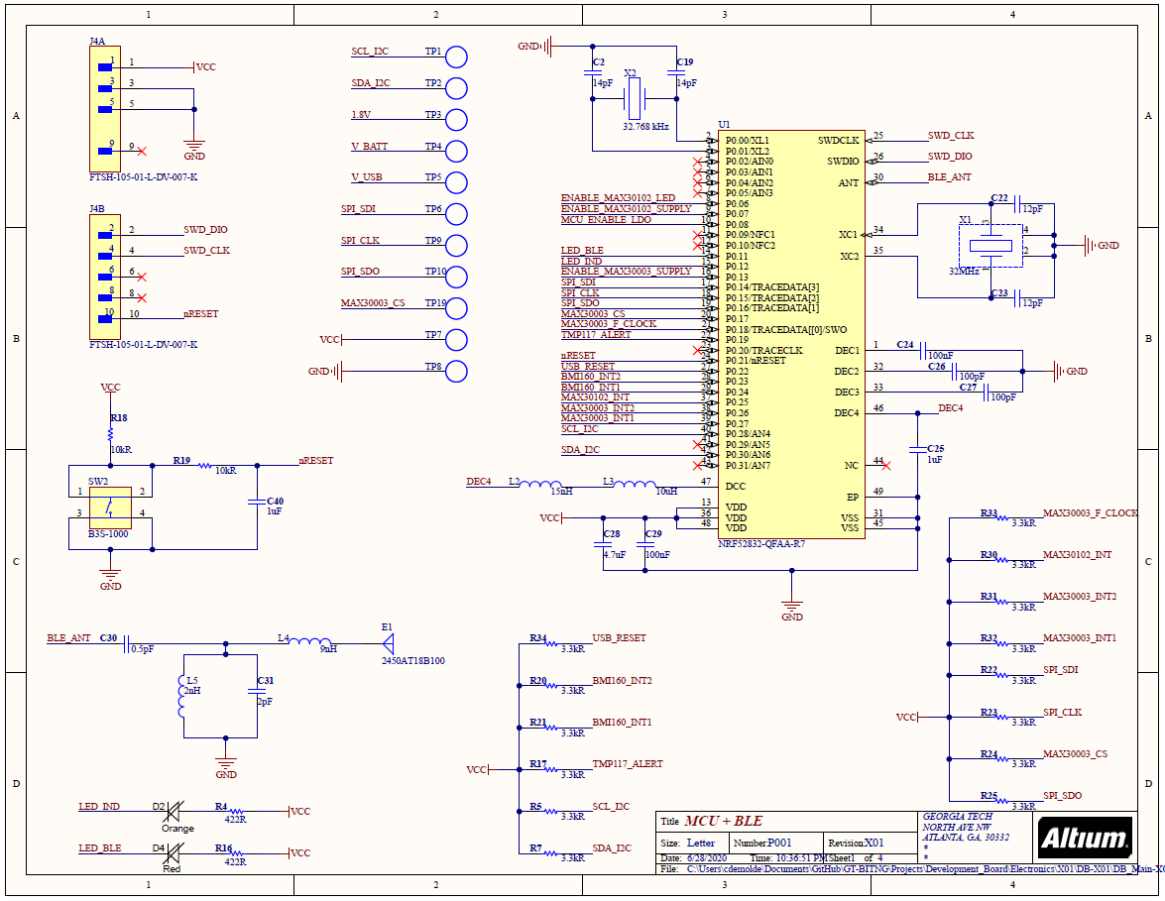
Progress to date: 6/28/2020

Slide 48
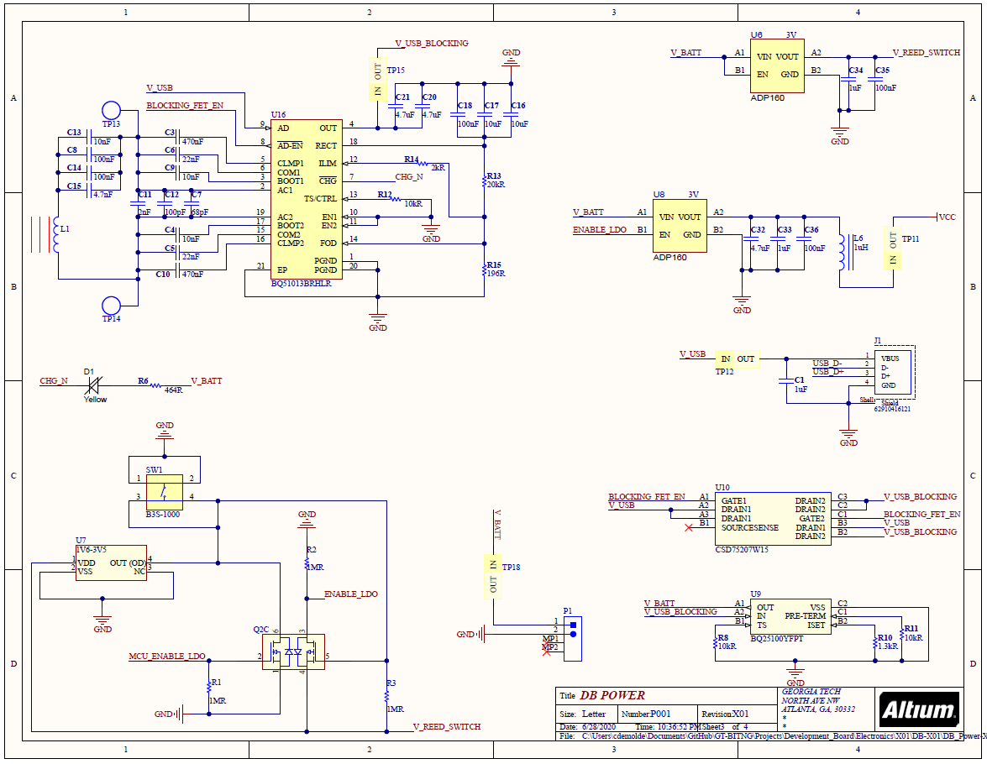
Progress to date: 6/28/2020

Slide 49
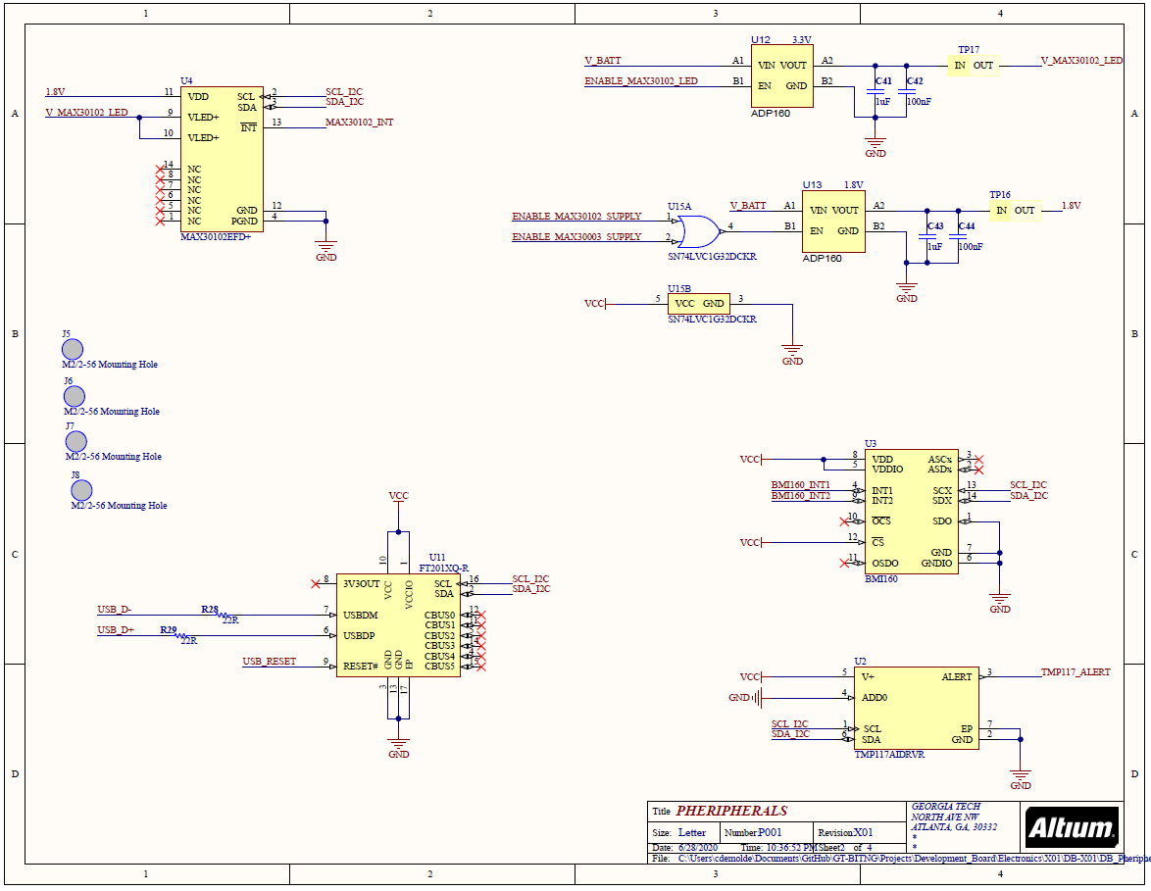
Progress to date: 6/28/2020

Slide 50
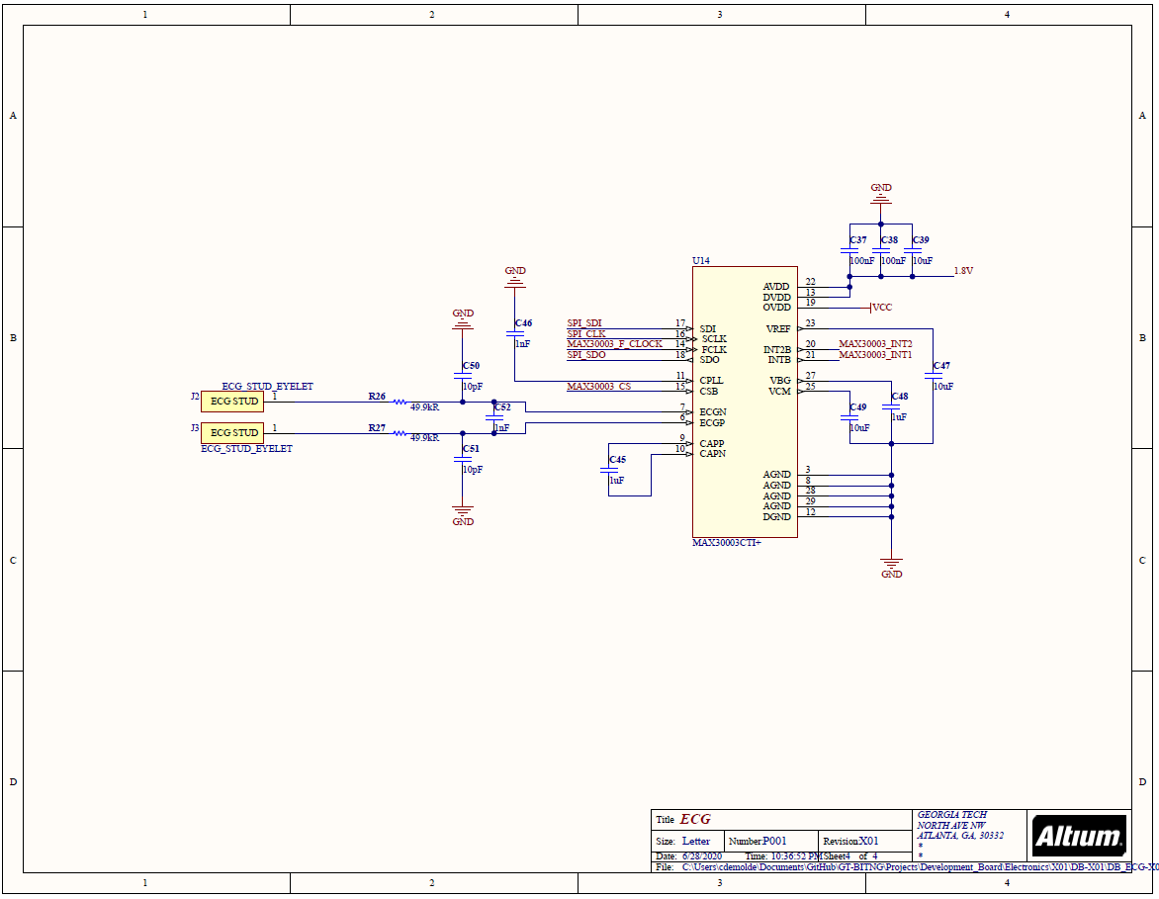
Progress to date: 6/28/2020

Slide 51
Electronics development: PCB design
PCB design
Major component layout (2 hours)
BLE antenna and impedance matching circuit (3 hours)
Wireless charging (2 hours)
Lithium battery charging (1 hours)
Overall board construction(1 hour)
USB charging (2 hours)
Biosensors: temperature, IMU, ECG (3 hours)
Test points, connectors, jumpers (1 hours)
Gerber file generation (2 hours)
BOM generation (2 hours)
Estimated time: 16 hours
Actual time spent: 20 hours

Slide 52
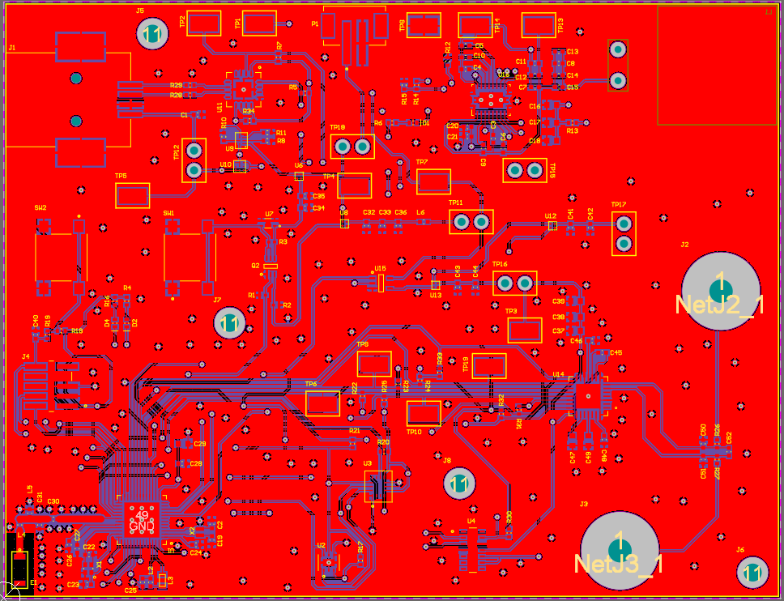
Progress to date: 6/28/2020

Slide 53
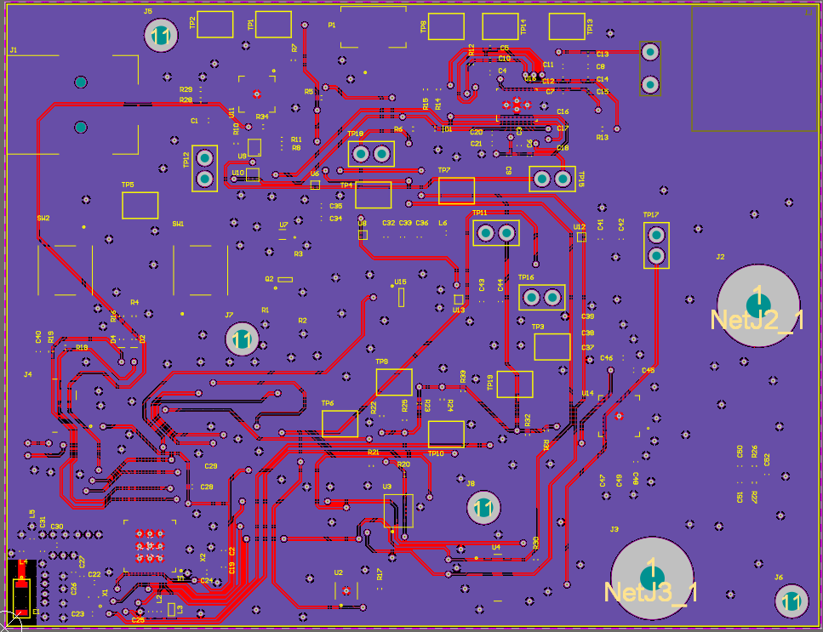
Progress to date: 6/28/2020

Slide 54
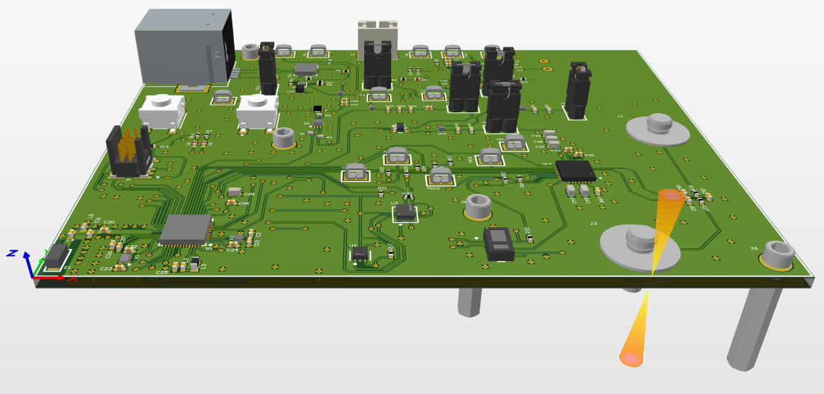
Progress to date: 6/28/2020

Slide 55
PCB manufacturing specifications
Dimensions: 99.568 x 76.454 mm
Layers: 2
Minimum trace/space: 6 mil
Minimum hole size: 12 mil
Thickness: 1.6mm
Solder mask: Green
Surface finish: HASL with lead
Copper weight: 1 oz
Material type: FR4

Slide 56
PCA quote
PCB Manufacturing:
Price: $20
Manufacturer: PCBMinions
Lead time: 4 days
BOM:
Price: ~$289.63
Board Quantity: 3
Supplier: Digikey/Mouser
Lead time: 1-5 days
Stencil:
Price: ~46.25
Supplier: OSH Stencil
Lead time: 5 days

Slide 57
Firmware development
Firmware
Project and BLE stack (5 hours)
Sensor drivers
I²C driver (4 hours)
Temperature driver (2 hours)
ECG driver (6 hours)
IMU driver (3 hours)
USB & RTT data logging (5 hours)
RTT data logging (2 hours)
USB data logging (3 hours)
DAQ slave protocol (1 hour)

Slide 58
PROJECT MANAGEMENT

Slide 59
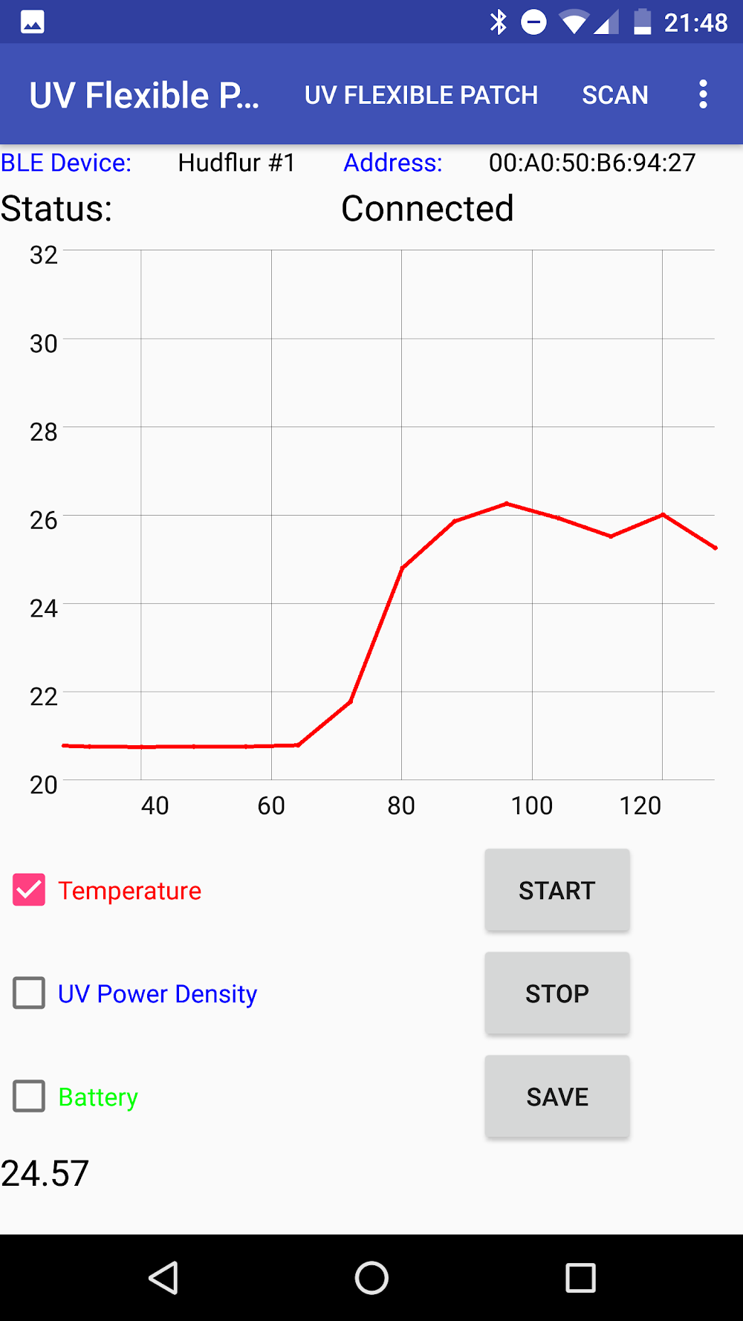
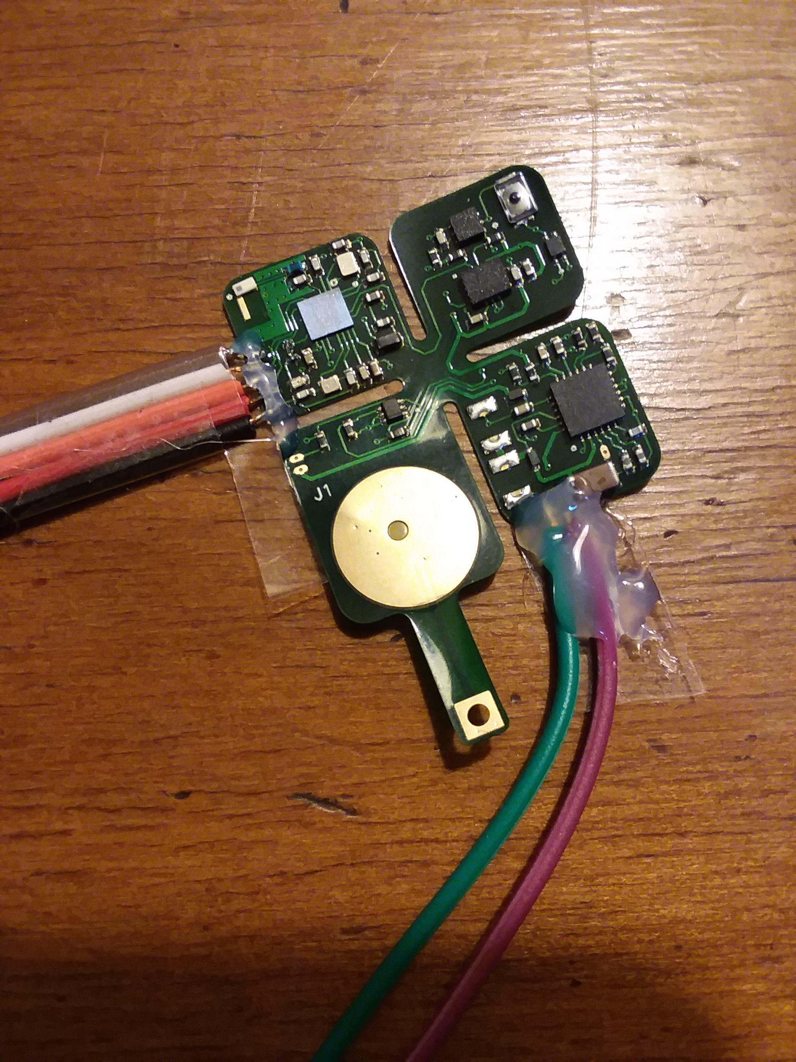

Introduction
Purpose:
Design a development board to test the functionality of different ‘plug-in-play’ sensors, wireless charging, and BLE communication. In the future, these sensors will be used in different combinations to build wearable devices.

Slide 60
Project management
Project status updates will be emailed to YSK and Dr. Yeo on a weekly basis by Monday morning (ET)
A rolling PowerPoint presentation will be used to document results and act as a final report
Each progress update will be timestamped, and the revision number will be incremented
Primary form of communication: email
Zoom/phone calls can not be conducted from 12 PM – 8 PM ET, Monday – Friday (due to my work schedule)
Project documents and resource will be available through my Github repository
Time commitment: average 10 hours/week

Slide 61
Project requirements
Requirements:
Design a development board PCB to demonstrate capabilities to connect to different bio-sensors
Development board must include the following functionality:
Wireless and USB charging
Battery management
USB data communication and logging
Use the nRF52832 MCU/SoC
BLE connectivity and BLE GATT database
Temperature sensing
Motion sensing
ECG
Capability to add more sensors in the future

Slide 62

Schedule overview
Electronics development
Date range: 6/1–7/31
Estimated hours to produce hardware: 49 hours
Estimated hours to test/debug/qualify hardware: TBD
Firmware development
Date range: 6/28-7/31
Estimated hours to produce firmware: 33 hours
Estimated hours to test/debug/qualify firmware: TBD
Any questions about the scope?
Let me know!

Slide 63
PROJECT PROPOSAL

Slide 64
Firmware development
Firmware
Project and BLE stack (5 hours)
Sensor drivers
I²C driver (4 hours)
Temperature driver (2 hours)
ECG driver (6 hours)
IMU driver (3 hours)
USB & RTT data logging (5 hours)
Future development*
BLE GATT database and data transfer (25 hours)*
Sensors: fuel gauge, H.R./Sp0₂ (8 hours)*
Data storage: EEPROM, Flash (8 hours)*
*Not in scope for current phase of development.

Slide 65
Hardware testing
Firmware testing
Firmware sensor functionality testing (8 hours)
Hardware testing
Overall hardware testing (5 hours)
Hardware sensor functionality testing (8 hours)
Future development*
Power consumption*
BLE range and connection testing*
*Not in scope for current phase of development.

Slide 66
Block diagram
PHERIPHERAL SENSORS
ANDROID PHONE**
PYTHON DATA LOGGER
IMU
BLE
BLE TX/RX
TEMPERATURE
USB
RF
SERIAL TO USB CONVERTER
SERIAL
MCU/SoC
SERIAL
ECG
POWER
OUT OF SCOPE
LIPO BATTERY
POWER
BMS
HR/Sp0₂**
POWER
BATTERY GAUGE**
WIRELESS
CHARGING COIL
POWER
WIRELESS CHARGING CIRCUITRY
**Not in scope for current phase of development.

Slide 67
PROJECT PROPOSAL: POWER CONSUMPTION TESTING
OUT OF SCOPE

Slide 68
Power consumption testing [TBD]
OUT OF SCOPE
Objective: Measure the power consumption of various sensors during operation, idle, and sleep mode
Log battery current and voltage at a defined sampling rate
Produce a power consumption model to determine battery life

Slide 69
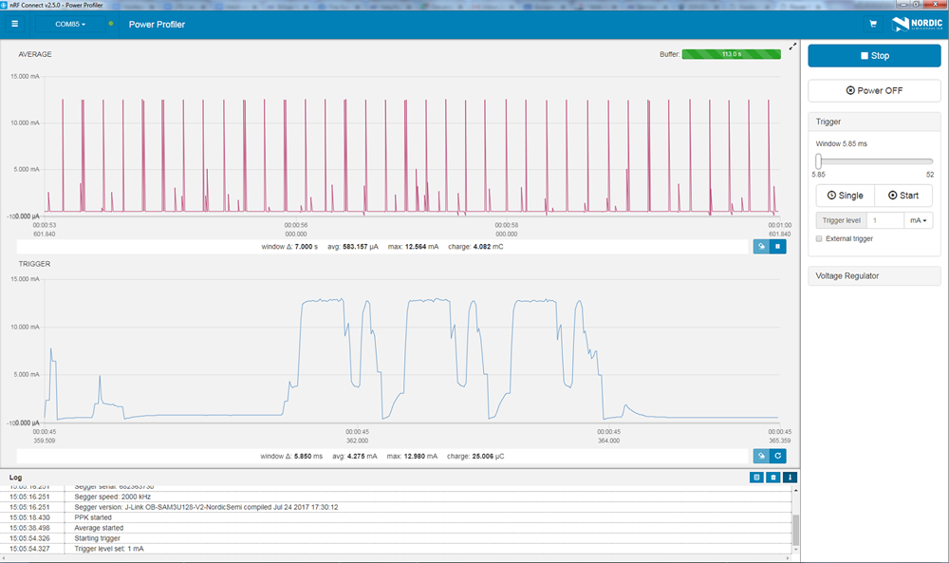
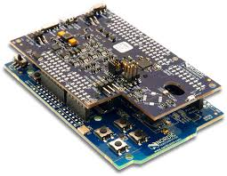
Power consumption testing [TBD]
OUT OF SCOPE
Nordic power profiler
Nano-amp resolution, fast sampling rate
See spikes of BLE transmission

Slide 70
Schedule flowchart: hardware
PROJECT
PROPOSAL
SCHEMATIC
GENERATION
PCB COMPONENT
LAYOUT
6/1–6/7; ~5 Hours
6/7–6/14; ~20 Hours
6/14–6/17; ~3 Hours
HARDWARE
TESTING*
FULL TURNKEY
PCB MFG.
PCB ROUTING
& MFG. FILE GENERATION
7/12–7/19; 5 Hours
6/28–7/12; ~4 Hours
6/17–6/28; ~12 Hours
OUT OF SCOPE
SENSOR FUNCTIONALITY TESTING*¹
POWER CONSUMPTION TESTING*²
BLE RANGE & CONNECTION
TESTING*²
7/19–7/31; 8 Hours
8/23–9/6; TBD
8/23–9/06; TBD
*Physical hardware needed to debug and perform testing.
¹Hardware functionality test of the sensors will be performed. Performance and accuracy will not be qualified. ²Not in scope for current phase of development.

Slide 71
Schedule flowchart: firmware
PROJECT
PROPOSAL
PROJECT STACK
ORGANIZATION
SENSOR
DRIVERS
7/1–6/7; ~5 Hours
6/28–7/2; ~5 Hours
7/2–7/12; ~15 Hours
OUT OF SCOPE
BLE GATT
DATABASE²
SENSOR FUNCTIONALITY TESTING*¹
SERIAL & RTT DATA LOGGING W/ PYTHON
8/16–8/23; ~25 Hours
7/19–7/31; ~8 Hours
7/5–7/12; ~5 Hours
POWER
CONSUMPTION
TESTING*^{1,2}
8/23–9/6; TBD
*Physical hardware needed to debug and perform testing.
¹Firmware functionality test of the sensors will be performed. Performance and accuracy will not be qualified.
²Not in scope for current phase of development.

Slide 72
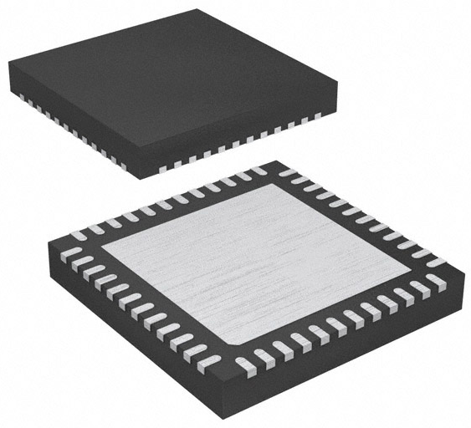
Component selection: MCU/BLE
MCU/BLE: nRF52832
6 pin, 2.00 mm x 2.00 mm, WSON-6
±0.1°C from -20°C to +50°C
2.4 GHz BLE
Power = 4 dBm
Sensitivity = -96 dBm
RAM = 64 kB, flash = 512 kB
Serial interfaces: I²C, UART, SPI
Supply voltage: 1.7V ~ 3.6V
$5.46 [X1], 1490-1067-1-ND, LINK
nRF52832

Slide 73
Component selection: clocks
HF clock: US3200005Z
4 pin, 1.60 mm x 1.20 mm, 4-SMD
32.00 MHz, 8 pF, ±10 ppm
$1.45 [X1], US3200005ZCT-ND, LINK
LF clock: ECX-1210
1210 package, 1.20 mm x 1.00 mm, 2-SMD
32.7680 kHz, 9 pF, ±20 ppm
$1.52 [X1], XC2283CT-ND, LINK
US3200005Z
ECX-1210

Slide 74
Component selection: USB/Serial
USB connector: 62910416121
4 pin, 16.00 mm x 10.62 mm, SMT type B
USB TYPE-B, USB 2.0, right angle
$3.83 [X1], 732-3152-1-ND, LINK
USB/I²C converter: FTDI FT201XQ-R
16 pin, 4.0 mm x 4.0 mm, 16-QFN
USB to I²C converter
3.4 Mbit/s
Low power consumption (8 mA)
$2.04 [X1], 768-1131-1-ND, LINK
62910416121
FT201XQ-R

Slide 75
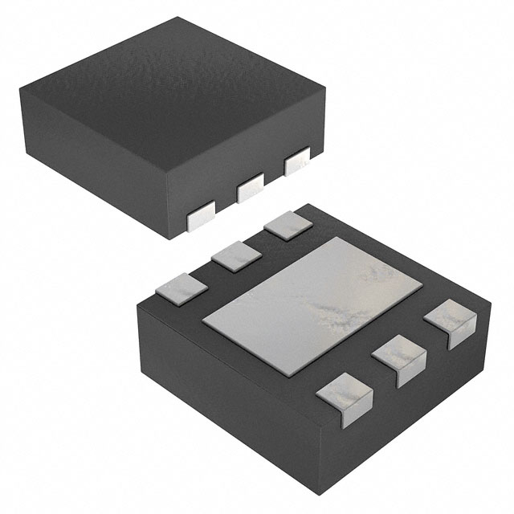
Component selection: Bio-sensors
Temperature: TI TMP117
6 pin, 2.00 mm x 2.00 mm, WSON-6
±0.1°C from -20°C to +50°C
16-bit resolution: 0.0078 °C, I²C
$8.02 [X1], 296-51834-1-ND, LINK
IMU: TI BQ27621-G1
14 pin, 2.5 mm x 3.0 mm, 14-LGA
I²C communication
9-axis, 16-bit resolution
Full operation mode = 925 uA
$4.98 [X1], 828-1057-1-ND, LINK
TMP117
BMI160

Slide 76
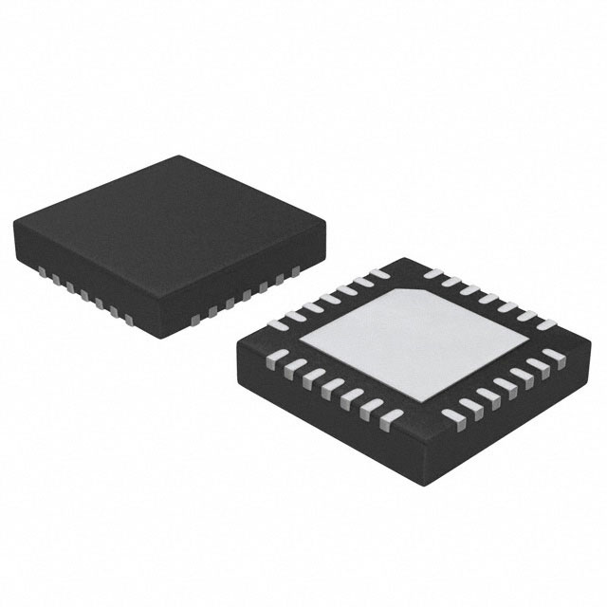
Component selection: Bio-sensors
OUT OF SCOPE
H.R. & Sp0₂: MAX30102
14 pin, 5.6 mm x 3.3 mm, 14-OESIP
Pulse oximetry and heart-rate
Temperature compensation, I²C
$9.51 [X1], MAX30102EFD+-ND, LINK
ECG: MAX30003
28 pin, 5.0 mm x 5.0 mm, 28-TQFN
SPI communication
15.5-bit resolution
Ultra-low power, single-channel integrated
$8.21 [X1], MAX30003CTI+-ND, LINK
MAX30102
MAX30003

Slide 77
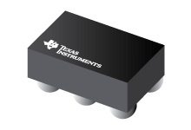
Component selection: wireless charging
Wireless charging IC: TI BQ51003
28 pin, 1.90 mm x 3.00 mm
QI v1.2 communication protocol
93% AC-DC efficiency
$3.00 [X1], 296-39952-1-ND, LINK
LiPo battery charger IC: TI BQ25100
6 pin, 1.6 mm x 0.90 mm, 4.2V 1 cell
1% Charge voltage accuracy
10 mA to 250 mA charging current
$2.24 [X1], 296-38373-1-ND, LINK
BQ51003
BQ25100

Slide 78
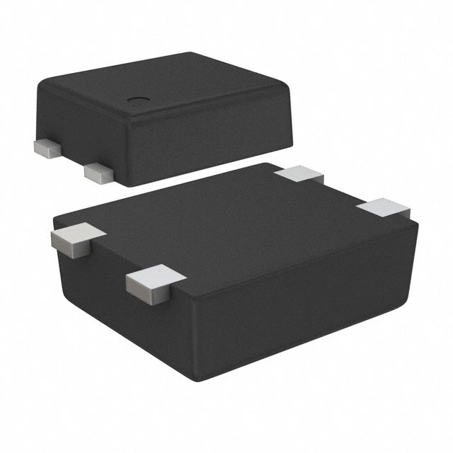
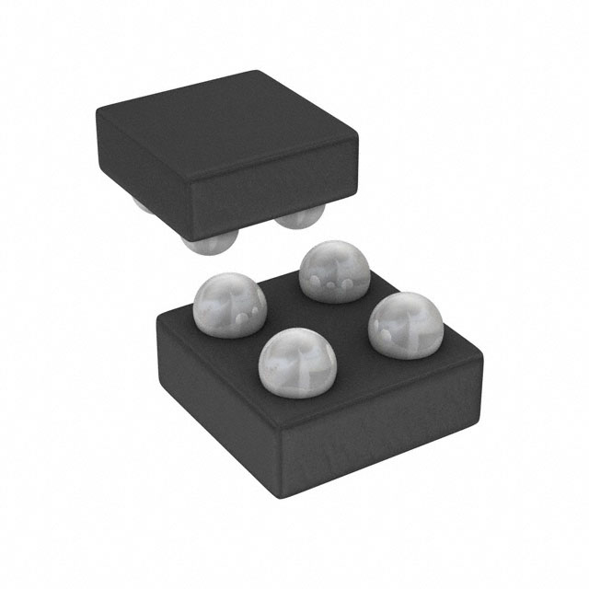
Component selection: power circuit
Reed Switch: ABLIC S-5712A
4 pin, 1.90 mm x 3.00 mm, SNT-4A
Non-contact ‘power switch’
High accuracy hall effect switch IC
$1.07 [X1], 1662-1617-1-ND, LINK
Linear Regulator: Analog Devices ADP172
4 pin, 0.95 mm x 1.03 mm, 4-WLCSP
0.1V dropout voltage
300 mA max current
$1.09 [X1], ADP172ACBZ-3.0-R7CT-ND, LINK
S-5712A
ADP172

Slide 79
Component selection: power circuit
Charging coil: Wurth 760308101219
1 coil, 1 layer, D=15 mm, H=0.6 mm
11.8 uH, 750 mΩ, t = ±10%
$7.43 [X1], 732-9675-ND, LINK
Fuel gauge: TI BQ27621-G1
9 pin, 1.62 mm x 1.58 mm, 9-DSBGA, 0.5 mm pitch
I²C communication
Dynamic voltage correlation algorithm
Battery capacity, state-of-charge, voltage
$2.21 [X1], 296-37460-1-ND, LINK
760308101219
OUT OF SCOPE
BQ27621-G1

Slide 80
Component selection: TBD
Components still need to be selected:
BLE antenna
BLE impedance matching circuit/filter
DCDC circuit

Slide 81
Possible functionality
Possible functionality:
Local data storage? (SD Card, EEPROM, etc…)
Type of ECG connector? (Digikey part number…)
NFC?
Any other ideas?

